Slide 1
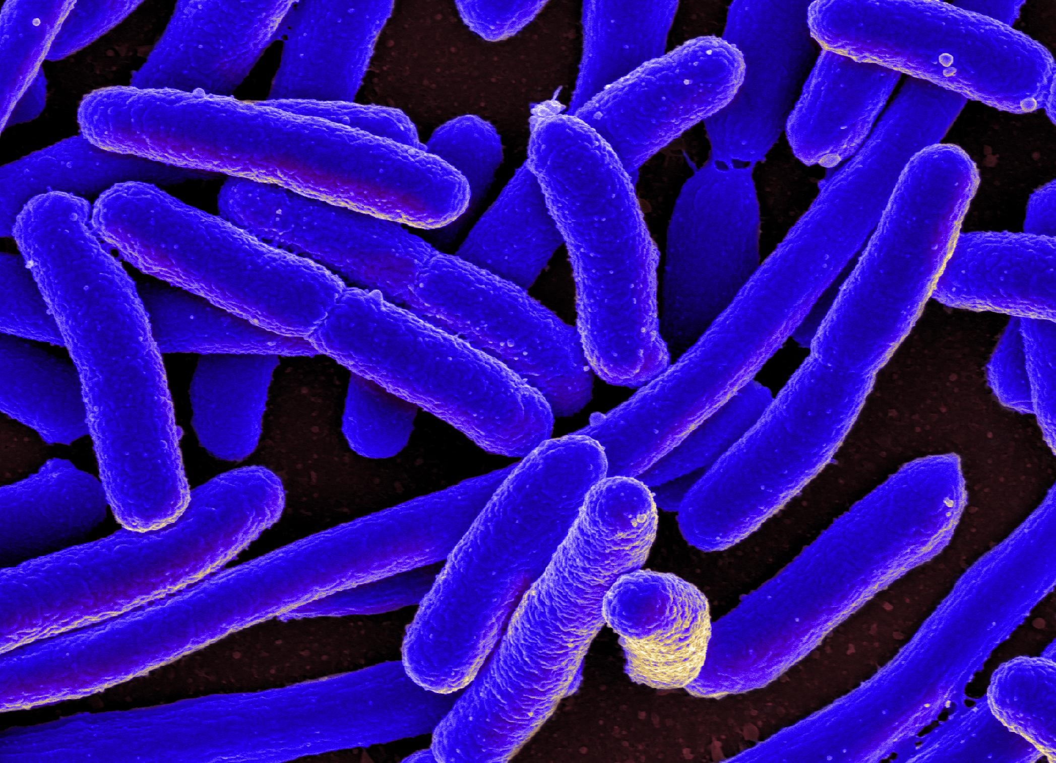
ENVIRONMENTAL FOOD CONTAMINATION
DISEASE DETECTIVES
SARA BURCHAM
ABHI SREELATHA PRABHU
DANYA KIYDAL
Notes:
Introduce myself and team members

Slide 2
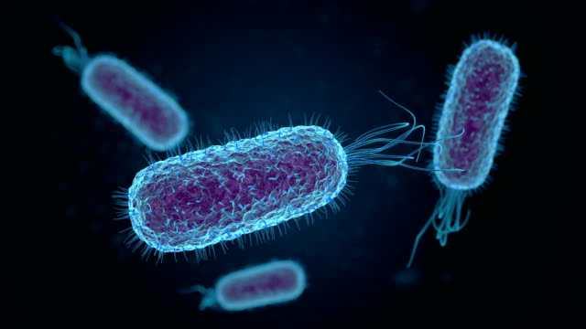
PART l
PART ll
PART lll
Describe outbreak scenario
Give you the tools to be a disease detective
Attack Rates
The Big 6 Microorganisms
Divide you into teams
Put your disease detective skills to the test
Sit with your teams
We will discuss the worksheet together
Your team will report the results of your investigation
Notes:
Overview of what we will be doing today

Slide 3
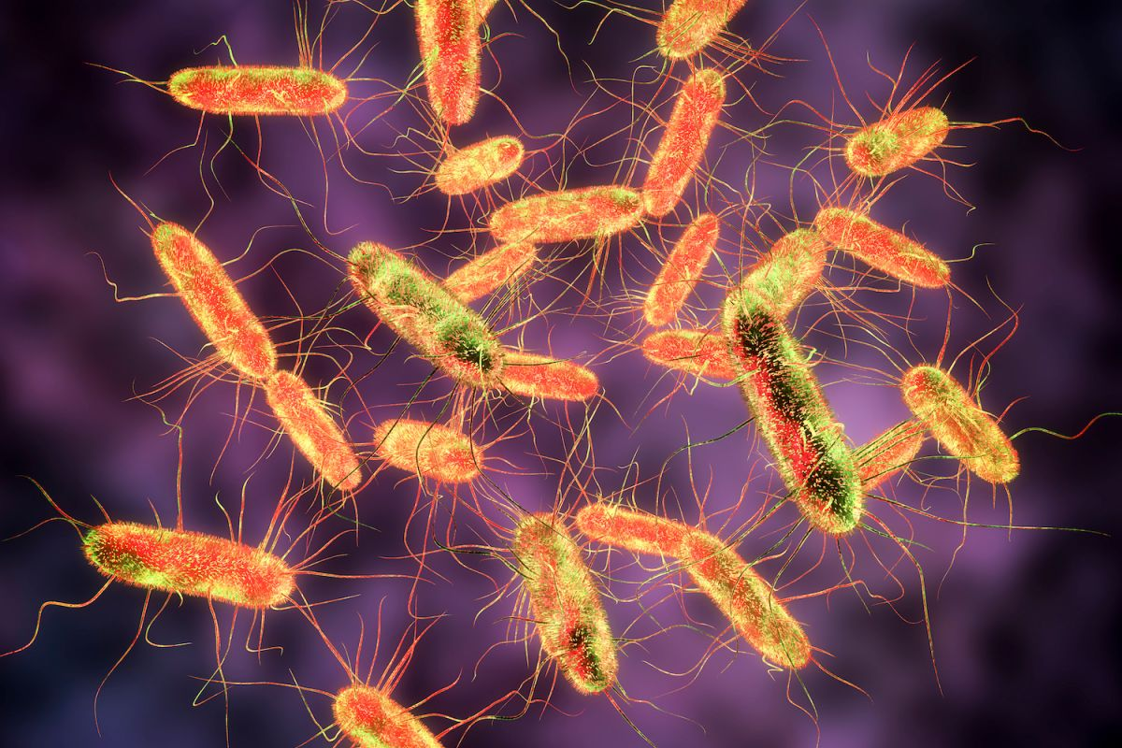
The Outbreak

Slide 4
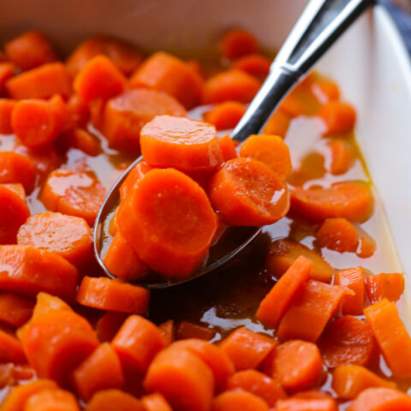

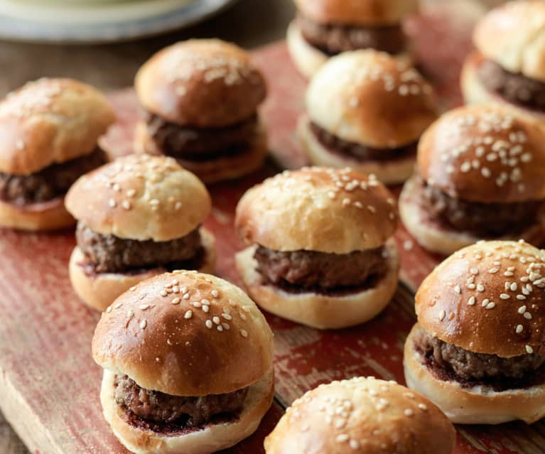

The 3rd grade students hosted a potluck lunch at their school and 100 students attended the luncheon.
Students, teachers, and staff volunteered to bring food and beverage items to the potluck.
The next day…
Common symptoms the students reported were stomach ache, fatigue, nausea, diarrhea, vomiting, and fever
20 students reported ill and did not come to school
Notes:
Sara
Explain the scenario

Slide 5
Food Item | # Ate | # Ate & Reported Ill | Attack Rate | # Did not Eat | # Did not Eat & Reported Ill | Rate
Steamed carrots | 45 | 5 | 11.1% | 55 | 4 | 7.3%
Green beans | 89 | 5 |  | 11 | 5 | 45.5%
Potato salad | 73 |  | 27.4% | 27 | 0
Stewed apples | 96 | 10 | 10.4% | 4 | 0 | 0.0%
House salad | 68 | 6 | 8.8% | 32 | 7
Ranch dressing | 50 | 1 | 2.0% | 50 | 9 | 18.0%
Vinaigrette dressing | 18 | 1 | 5.0% | 82 | 8 | 9.7%
Hamburgers | 91 | 15 | 16.5% | 9 | 0 | 0.0%
Milk | 30 | 5 | 16.7% | 70 | 20
Water | 100 | 15 | 15.0% | 0 | 0 | 0.0%
Fruit cup |  | 4 | 5.0% | 20 | 4 | 5.0%
Chocolate cookie | 14 | 5 |  | 86 | 6 | 6.9%
Cupcake | 20 | 1 | 5.0% | 80 | 19 | 23.8%
Notes:
Sara
This is an attack rate chart. It is typically created by a member of the local health department, or the CDC if the outbreak becomes multi-state, by interviewing each student to determine what they consumed and did not consume and if they reported ill during the outbreak time period. Let’s go through it. On the far left column, there is each food item that was served during the school potluck. Next, there is the number of students who attended the potluck and ate the food item. In the next column, there are the number of students who ate the food item and reported ill the next day. The fourth column has the attack rate reported as a percentage. A high attack rate means that out of the number of students who ate that particular food item, a large proportion of them became ill after eating. The next 3 columns decide the rate of students who did not eat the food item but still reported ill. A high rate indicates that food item is probably not the source of the outbreak since the students didn’t eat it but they still became ill. The rate is also reported as a percentage. You will notice the person who created this attack rate chart forgot to fill in some pieces of information that is important to your investigation. Therefore, your team will be responsible for completing the missing pieces of information by the end of this activity. First, let’s fill in some of the information together.

Slide 6
Attack Rate Formula
Attack Rate = (# of students who ate the food and reported ill / # students who ate the food) * 100
Chocolate Chip Cookie Attack Rate:
X = (5 / 14) * 100
Notes:
Sara
Let’s walk through how to calculate a missing attack rate in our chart.
(Each section will be set to display on the slide separately)

Slide 7
Attack Rate Formula
Attack Rate = (# of individuals who ate the food and reported ill / # individuals who ate the food) * 100
Chocolate Chip Cookie Attack Rate:
X = (5 / 14) * 100
X = 35.7%
What might a high attack rate indicate?
2. How high is the attack rate of the cookie compared to the other food items?
Notes:
Sara
Let’s walk through how to calculate a missing attack rate in our chart.
(Each section will be set to display on the slide separately)

Slide 8
Rate Formula
Rate = (# of students who did not eat the food and reported ill / # students who did not eat) * 100
House Salad Rate:
X = (7 / 32) * 100
Notes:
Sara
Let’s walk through how to calculate a missing rate and go through some related concepts.
A high rate probably means that food item isn’t the source of the outbreak because the students reported ill even when they didn’t eat that particular food item.
A high attack rate and a low rate means that food item should be one of concern because a high proportion of students became ill when eating that food item and those who didn’t eat the food item didn’t become ill.
A high attack rate and a high rate could be a tricky situation. It is possible the food item is the source of the outbreak because of the high rate, however, because of the high rate, it means people who didn’t eat the item also became sick. This may suggest that students who ate the contaminated food item also ate this particular item. It would make sense if the contaminated item was a beverage or main course and then this item was a side dish, for example.

Slide 9
Rate Formula
Rate = (# of individuals who did not eat the food and reported ill / # individuals who did not eat) * 100
House Salad Rate:
X = (7 / 32) * 100
X = 21.9%
What might a high rate indicate?
2. What does a low rate indicate?
Notes:
Sara
Let’s walk through how to calculate a missing rate and go through some related concepts.
A high rate probably means that food item isn’t the source of the outbreak because the students reported ill even when they didn’t eat that particular food item.
A low rate may mean that the food item could be of concern, especially if it also has a high attack rate, because it means that those who did not eat the food item didn’t become ill.
A high attack rate and a low rate means that food item should be one of concern because a high proportion of students became ill when eating that food item and those who didn’t eat the food item didn’t become ill.
A high attack rate and a high rate could be a tricky situation. It is possible the food item is the source of the outbreak because of the high rate, however, because of the high rate, it means people who didn’t eat the item also became sick. This may suggest that students who ate the contaminated food item also ate this particular item. It would make sense if the contaminated item was a beverage or main course and then this item was a side dish, for example.

Slide 10
Food Item | # Ate | # Ate & Reported Ill | Attack Rate | # Did not Eat | # Did not Eat & Reported Ill | Rate
Steamed carrots | 45 | 5 | 11.1% | 55 | 4 | 7.3%
Green beans | 89 | 5 |  | 11 | 5 | 45.5%
Potato salad | 73 |  | 27.4% | 27 | 0
Stewed apples | 96 | 10 | 10.4% | 4 | 0 | 0.0%
House salad | 68 | 6 | 8.8% | 32 | 7 | 21.9%
Ranch dressing | 50 | 1 | 2.0% | 50 | 9 | 18.0%
Vinaigrette dressing | 18 | 1 | 5.0% | 82 | 8 | 9.7%
Hamburgers | 91 | 15 | 16.5% | 9 | 0 | 0.0%
Milk | 30 | 5 | 16.7% | 70 | 20
Water | 100 | 15 | 15.0% | 0 | 0 | 0.0%
Fruit cup |  | 4 | 5.0% | 20 | 4 | 5.0%
Chocolate cookie | 14 | 5 | 35.7% | 86 | 6 | 6.9%
Cupcake | 20 | 1 | 5.0% | 80 | 19 | 23.8%
Notes:
We filled in some of the values together. Now that you learned how to calculate the missing values, you and your team must fill in the remaining values on your worksheet by the end of the activity. Questions?
Let’s move on to learning about “The Big 6 Microorganisms that cause foodborne illness in the U.S.”

Slide 11
Missing values for # who ate/ did not eat
# who ate & reported ill
Attack rate (%)
# total who ate
100%
Fruit cup # who ate:
4 / X = 5.0% / 100%
Notes:
Sara
Finally, let’s walk through how to calculate other missing values in our chart by using the cross-multiply and divide protocol.
Be sure to round up to the nearest whole number as there can’t be fractions of people who consumed an item (we are whole people!)

Slide 12
Missing values for # who ate/ did not eat
# who ate & reported ill
Attack rate (%)
# total who ate
100%
X – placeholder for the total # of students who ate the fruit cup
4 / X = 5.0% / 100%
Find X:
4 * 100 = 5.0 * X → 400/5.0 = X → 80 students who ate the fruit cup total
Notes:
Sara
Finally, let’s walk through how to calculate other missing values in our chart by using the cross-multiply and divide protocol.
Be sure to round up to the nearest whole number as there can’t be fractions of people who consumed an item (we are whole people!)

Slide 13
Food Item | # Ate | # Ate & Reported Ill | Attack Rate | # Did not Eat | # Did not Eat & Reported Ill | Rate
Steamed carrots | 45 | 5 | 11.1% | 55 | 4 | 7.3%
Green beans | 89 | 5 |  | 11 | 5 | 45.5%
Potato salad | 73 |  | 27.4% | 27 | 0
Stewed apples | 96 | 10 | 10.4% | 4 | 0 | 0.0%
House salad | 68 | 6 | 8.8% | 32 | 7 | 21.9%
Ranch dressing | 50 | 1 | 2.0% | 50 | 9 | 18.0%
Vinaigrette dressing | 18 | 1 | 5.0% | 82 | 8 | 9.7%
Hamburgers | 91 | 15 | 16.5% | 9 | 0 | 0.0%
Milk | 30 | 5 | 16.7% | 70 | 20
Water | 100 | 15 | 15.0% | 0 | 0 | 0.0%
Fruit cup | 80 | 4 | 5.0% | 20 | 4 | 5.0%
Chocolate cookie | 14 | 5 | 35.7% | 86 | 6 | 6.9%
Cupcake | 20 | 1 | 5.0% | 80 | 19 | 23.8%
Notes:
We filled in some of the values together. Now that you learned how to calculate the missing values, you and your team must fill in the remaining values on your worksheet by the end of the activity. Questions?
Let’s move on to learning about “The Big 6 Microorganisms that cause foodborne illness in the U.S.”

Slide 14
Disease Detective Tools

Slide 15
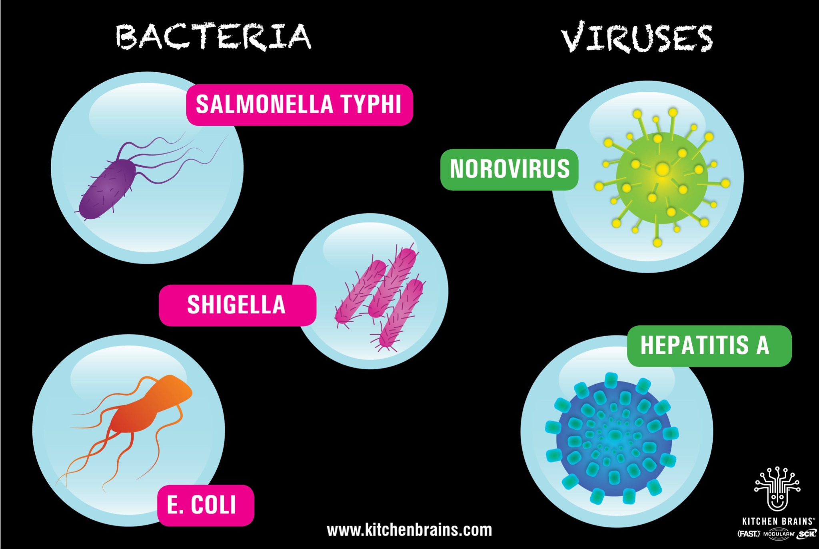
The “Big 6” Microorganisms in Food Safety
NON-TYPHOIDAL
Notes:
The microorganisms listed here are called “The Big 6” because they are the primary contributors to foodborne illness in the U.S. as defined by the Food and Drug Administration. The CDC states there are around 126,000 hospitalizations from foodborne diseases each year in the U.S., the majority of those hospitalizations coming from these organisms. This value is believed to be under-reported by 25-30%. Why do you think that is? (pause for responses). The reason is that the majority of these microorganisms cause acute or self-limiting reactions that last between 24-72 hours. The more serious cases can last for weeks or have residual effects for years. For example, people who have more severe cases of E. coli can develop kidney infection and can experiences symptoms of IBS for years after their E. coli diagnosis. Long story short, we want to prevent infection from these organisms.
You can see there are four types of bacteria and there are two types of viruses. I want to make a distinction between Salmonella typhi and non-typhoidal Salmonella. “Typhi” refers to the species of Salmonella and non-typhoidal refers to everything else. There are over 200 serotypes of Salmonella identified but typhi is of particular interest because it causes more severe infections compared to the other species.

Slide 16
 | Salmonella | Salmonella typhi | Shigella | E. coli | Hepatitis A | Norovirus
Morphology | Rod | Rod | Rod | Rod | N/A | N/A
Origins | Fecal-oral*, poor handwashing, improper sewage control, consuming contaminated food, wildlife & agriculture contamination, handling baby diapers, soil harborage
Symptoms | Fever, headache, fatigue, sweating, dry cough, stomach pain, weight loss, diarrhea, typhoid fever* |  | Fever, diarrhea, dehydration, stomach tenderness | Severe diarrhea, vomiting, stomach cramps | Yellow skin/eyes (jaundice)*, anorexia, fever, stomach pain | Projectile vomiting*, diarrhea, stomach cramps
Prevention | Handwashing, Cook food >140F | Handwashing, Vaccination, Don’t wash F&V in water, Don’t eat ice, Bottled water in countries with poor sanitation/ sewage practices | Handwashing, avoid food preparation if infected, high cook temperature | Handwashing, preventing anaerobic environments*, cutting board safety | Handwashing, vaccination, blood-borne safety e.g., avoid sharing food in endemic areas | Handwashing, respiratory hygiene
Notes:
There are a lot of similarities between what the students reported and what is normally caused by some of the Big 6 organisms. The problem is… there are a lot of overlapping symptoms between the organisms, so we can’t diagnose the microbe that infected students based on symptoms alone.
Handwashing is the most important prevention practice for all foodborne illnesses. This is because our hands act as vectors between surfaces and food items. If we touch food after we have touched the surface of a contaminated surface (e.g., a cutting board) or after going to the restroom then we have contaminated that food item. Cooking food to a high temperature to kill off the organism and avoiding unclean drinking water/ ice are also good prevention practices.

Slide 17
 | Salmonella | Salmonella typhi | Shigella | E. coli | Hepatitis A | Norovirus
Morphology | Rod | Rod | Rod | Rod | N/A | N/A
Origins | Fecal-oral*, poor handwashing, improper sewage control, consuming contaminated food, wildlife & agriculture contamination, handling baby diapers, soil harborage
Symptoms | Fever, headache, fatigue, sweating, dry cough, stomach pain, weight loss, diarrhea, typhoid fever* |  | Fever, diarrhea, dehydration, stomach tenderness | Severe diarrhea, vomiting, stomach cramps | Yellow skin/eyes (jaundice)*, anorexia, fever, stomach pain | Projectile vomiting*, diarrhea, stomach cramps
Prevention | Handwashing, Cook food >140F | Handwashing, Vaccination, Don’t wash F&V in water, Don’t eat ice, Bottled water | Handwashing, avoid food preparation if infected, high cook temperature | Handwashing, preventing anaerobic environments*, cutting board safety | Handwashing, vaccination, blood-borne safety e.g., avoid sharing food in endemic areas | Handwashing, respiratory hygiene
What similarities do you see in the symptoms that the ill students reported?
What are prevention practices shared between all six microbes?
Notes:
There are a lot of similarities between what the students reported and what is normally caused by some of the Big 6 organisms. The problem is… there are a lot of overlapping symptoms between the organisms, so we can’t diagnose the microbe that infected students based on symptoms alone.
Handwashing is the most important prevention practice for all foodborne illnesses. This is because our hands act as vectors between surfaces and food items. If we touch food after we have touched the surface of a contaminated surface (e.g., a cutting board) or after going to the restroom then we have contaminated that food item. Cooking food to a high temperature to kill off the organism and avoiding unclean drinking water/ ice are also good prevention practices.

Slide 18
Questions?

Slide 19
Divide into groups to visit four workstations
You will need your worksheet and a pencil
You will spend 10 minutes at each scenario presented
The Winning Team will tell us…
The food item that was likely contaminated
The microorganism that caused the outbreak
The scenario the food item came from (1, 2, or 3)
The action that led to the contamination
How it could have been prevented
One thing you learned from being a disease detective

